Slide 1

Product Management
Certification Program
Industry Project - I
Notes:
© Copyright UpGrad Education Pvt. Ltd. All rights reserved

Slide 2
Submission Guidelines
After completing all the parts of the project, you will have to submit your responses in the following manner.
Submit the following parts of the project in this “Presentation’’ file
Part 1 - Understanding the market
Part 2 - User research
Part 5 - MVP Creation
Part 6 - Sketching
Part 7 - Wireframing & Prototyping
Submit the following part of the project in the template document provided on the platform.
Part 3 - Business Model Canvas
Part 4 - Product Artifacts
User Persona
User Journey Map
Note: Finally you have to add this Presentation & other submission documents in a ZIP folder and upload it in the submission section on the platform. More details in slides to follow
Notes:
© Copyright UpGrad Education Pvt. Ltd. All rights reserved

Slide 3
Part 1: Understanding the Market
Notes:
© Copyright UpGrad Education Pvt. Ltd. All rights reserved

Slide 4
Target Market Identification
Problem statement: How big is the daily meal ordering market in urban cities in India?
Assumptions
Targeting only urban cities
Targeting males and females
People who are living away from their families in urban cities would be dependent on outside food
Migrants in urban cities would not be living with their families
Migrants specifically, students or those who are working would be relying on outside food
Working migrants those are unmarried would be relying on the outside food
37% of urban population are migrants where 3% migrate for education and 15% for employment
Considering 50% of migrants for employment are unmarried
Notes:
© Copyright UpGrad Education Pvt. Ltd. All rights reserved

Slide 5
Target Market Identification
Problem statement:
How big is the daily meal ordering market in urban cities in India?
Total available market (TAM) – Total population living in the urban cities
Serviceable available market (SAM) – Students and working professionals in the urban cities
Target segment - Unmarried migrants living away from family and relying on outside food
Notes:
© Copyright UpGrad Education Pvt. Ltd. All rights reserved

Slide 6
Target Market Identification
Problem statement:
How big is the daily meal ordering market in urban cities in India?
Market Sizing (taking round figures)
Total Population of India : 1.3B. (source: https://data.worldbank.org/indicator/SP.POP.TOTL?locations=IN )
Urban population : 30% of total population = 390M
Total migrants in Urban cities = 37% of Urban population = 37% of 390M = 144M
(Source: https://censusindia.gov.in/Census_And_You/migrations.aspx)
Migrants for Education = 3% of total migrants = 3% of 144M = 4.3M
Migrants for work/employment = 15% of total migrants = 15% of 144M = 21.6M
(Source: https://censusindia.gov.in/Census_And_You/migrations.aspx)
Unmarried migrants for work/employment = 50% of total migrants for work/employment = 50% of 21.6M = 10.8M (source: https://www.censusindia.gov.in/vital_statistics/srs_report/9chap%202%20-%202011.pdf )
Total market size = Migrants for Education + Unmarried migrants for work/employment = 4.3M + 10.8M = 15M
Notes:
© Copyright UpGrad Education Pvt. Ltd. All rights reserved

Slide 7
Target Market Identification
Reference sources :
https://data.worldbank.org/indicator/SP.POP.TOTL?locations=IN
https://censusindia.gov.in/2011-prov-results/paper2/data_files/india/Rural_Urban_2011.pdf
https://censusindia.gov.in/Census_And_You/migrations.aspx
https://www.censusindia.gov.in/vital_statistics/srs_report/9chap%202%20-%202011.pdf
Notes:
© Copyright UpGrad Education Pvt. Ltd. All rights reserved

Slide 8
Porter's Five Forces Analysis
Threat of new entrants – High.
The threat of new entrants is high for the food-tech industry because –
There is no differentiation in the products
The initial capital investment required is low
It is easy to setup an online presence and deliver goods using various logistics providers
Switching cost of consumers is less
Many hyperlocal food delivery apps mushrooming
The entry barriers are low and hence it makes the industry competitive and also decreases the potential for earning profits.
Bargaining power of buyer - High.
The bargaining power of buyers is high because -
The number of buyers in the market is quite large and most are highly price-sensitive
As the products being sold do not have strong differentiation it is hard for sellers to negotiate with buyers
Buyers can easily compare the prices. Deals across various sellers and end up choosing the cheapest one
The availability of substitute products and low switching costs give a lot of power to buyers.
Notes:
© Copyright UpGrad Education Pvt. Ltd. All rights reserved

Slide 9
Porter's Five Forces Analysis
Threat of substitute products - High.
The threat of substitute products is high because -
Cheaper products with equal or higher quality are available
Due to low switching cost the industry is highly price-sensitive
Substitute products perform similarly or better
New business model of home made food delivery already exist
There is no brand loyalty among the consumers as they always lookout for deals.
Bargaining power of suppliers - High.
The suppliers have a high bargaining power because -
Suppliers have the power to negotiate with the buyers
The suppliers can set up their own websites for selling directly to increase their margins
Logout campaigns held by the suppliers union against forced discounting model
Suppliers can switch to the new platforms
The suppliers have high bargaining power because they are selling products on multiple websites.
Notes:
© Copyright UpGrad Education Pvt. Ltd. All rights reserved

Slide 10
Porter's Five Forces Analysis
Intensity of rivalry - High.
There is very high rivalry in this sector because -
There are a lot of players with similar products and also the switching cost is low
The brand loyalty among consumers is low
The major players have somewhat equal market share and it is tough to increase market share
The intensity of rivalry is high because of a lot of players in the market with similar products.
Notes:
© Copyright UpGrad Education Pvt. Ltd. All rights reserved

Slide 11
Porter's Five Forces Template
Threat of Entry
There is no differentiation in the products
The initial investment required is low
It is easy to setup an online presence and deliver goods using various logistics providers
Bargaining Power of Buyers
The number of buyers in the market is quite large and most are highly price-sensitive
As the products being sold do not have strong differentiation it is hard for sellers to negotiate with buyers
Buyers can easily compare the prices. Deals across various sellers and end up choosing the cheapest one
Competitive Rivalry
There are a lot of players with similar products and also the switching cost is low
The brand loyalty among consumers is low
The major players have somewhat equal market share and it is tough to increase market share
Bargaining Power of Suppliers
Suppliers have the power to negotiate with the buyers
The suppliers can set up their own websites for selling directly to increase their margins
Logout campaigns held by the suppliers union against forced discounting model
Threat of Substitutes
Cheaper products with equal or higher quality are available
Due to low switching cost the industry is highly price-sensitive
Substitute products perform similarly or better
Notes:
© Copyright UpGrad Education Pvt. Ltd. All rights reserved

Slide 12
Competitor Analysis
List of major players in the online food-tech industry in India
Swiggy
Zomato
FreshMenu
Faasos
Dunzo
Box8
Masala box
Two direct competitors for our product are –
Swiggy
Masala box
Notes:
© Copyright UpGrad Education Pvt. Ltd. All rights reserved

Slide 13
Competitor Analysis
SWIGGY Vs MASALA BOX
 | PARAMETERS | SWIGGY | MASALA BOX
Company specific | Goal | Swiggy's objective is to integrate with restaurant partners and provide an optimal experience to our customers | We are a group of food enthusiasts, working towards a collective goal of making homemade food door deliverable to the urban population.
 | Mission | Swiggy's vision is to elevate the quality of life of urban consumers by offering unparalleled convenience | Good food should be convenient, diverse, healthy, and above all delicious. We are redefining the ordering in experience with a vertically integrated food delivery company. By leveraging a vast home chef network and our own logistics team, we provide a tastier, healthier alternative to eating commercially prepared food.
Notes:
© Copyright UpGrad Education Pvt. Ltd. All rights reserved

Slide 14
Competitor Analysis
SWIGGY Vs MASALA BOX
 | PARAMETERS | SWIGGY | MASALA BOX
Company specific | # of employees | 12,609 | 22
 | Investment funding | In Apr, 2020 Swiggy has invested in Fingerflix company which is a semi-cooked food delivery company that creates delightful experience for customers. | No external funding
 | Revenue details | $181.6M | < $ 1M
Notes:
© Copyright UpGrad Education Pvt. Ltd. All rights reserved

Slide 15
Competitor Analysis
SWIGGY Vs MASALA BOX
 | PARAMETERS | SWIGGY | MASALA BOX
Company specific | Founder's profile | Sriharsha Majety (CEO and Co-founder) Higher education - PGDM, Finance from Indian institute of Management, Calcutta 10 years of rich experience Earlier he was a co-founder of Bundl | Harsha Thachery (Founder & CEO) Higher education - CA from The Institute Of Chartered Accountants Of India. 9 Years and 8 months of rich experience Earlier worked as a GM at ChaYoWo games
Notes:
© Copyright UpGrad Education Pvt. Ltd. All rights reserved

Slide 16
Competitor Analysis
SWIGGY Vs MASALA BOX
 | PARAMETERS | SWIGGY | MASALA BOX
Company specific | Acquisitions | So far Swiggy has acquired 3 companies – Kint - Kint is an AI-based sports analytics platform that offers ball trajectory tracking, facial recognition and plane surface detection solutions. Supr Techlabs Pvt. Ltd. - Supr Daily is a subscription-based application that allows users to shop for milk, egg, fruits and vegetables. Scootsy Logistics Pvt. Ltd. - Scootsy is an online platform that enables users to search and order food from restaurants. | No acquisitions
Notes:
© Copyright UpGrad Education Pvt. Ltd. All rights reserved

Slide 17
Competitor Analysis
SWIGGY Vs MASALA BOX
 | Parameters | SWIGGY | MASALA BOX
Company specific | Target markets | They are operating in over 500 cities in India | Bangalore (India)
 | Founded | 2014 | 2014
 | Funding | Total funding so far is $1.6B | No info
Notes:
© Copyright UpGrad Education Pvt. Ltd. All rights reserved

Slide 18
Competitor Analysis
SWIGGY Vs MASALA BOX
 | Parameters | 1mg | PharmEasy
Target customers | Product | Food ordering app, they have both mobile and desktop application | Masala box (100% homemade food delivery), they have both mobile and desktop application
 | Primary buyer/Decision maker | Ordering food from restaurants Ordering groceries, food & vegetables | Homemade daily meals order (breakfast/lunch/dinner)
 | Secondary buyer | Ginie - Anything the customer need, delivered. Pick-up, Drop or buy anything, from anywhere in your city. | Providing customisable menu for the parties (Celebrate birthdays, promotions, housewarmings, anniversaries)
Notes:
© Copyright UpGrad Education Pvt. Ltd. All rights reserved

Slide 19
Competitor Analysis
SWIGGY Vs MASALA BOX
 | Parameters | SWIGGY | MASALA BOX
Target customers | Target customer | Target audience - 18-35 demographic, which has easy access to a smartphone, is fluent with using apps to get services and looks towards online platforms to fulfil their daily necessities. | Urban population, those who want homemade food instead of restaurant food for a daily meals.
Notes:
© Copyright UpGrad Education Pvt. Ltd. All rights reserved

Slide 20
Competitor Analysis
SWIGGY Vs MASALA BOX
 | Parameters | SWIGGY | MASALA BOX
Business models | Business strategy | It is working on an Aggregator model. They have onboarded multiple restaurants to provide wide variety of food to the customers. Swiggy has also started delivering the daily essentials to the customers from their nearby shops. | It is working on an Aggregator model. They have onboarded multiple local home kitchens those provide the daily meals that cooked in their kitchens to the customers Customers can select the meal plan form the multiple options and register for the subscription to have daily meals from the local kitchens. They provide all the operational facilities to the home-made food suppliers
Notes:
© Copyright UpGrad Education Pvt. Ltd. All rights reserved

Slide 21
Competitor Analysis
SWIGGY Vs MASALA BOX
 | Parameters | SWIGGY | MASALA BOX
Business models | Value-added services | Swiggy sides & Drinks is a value-added service where a customer can add/pair extra items to their orders to make it the perfect wholesome meal. These can be beverages, desserts, or accompaniments/extras | Providing food recipes Food blogs
 | Geographical reach | Over 500 cities in India | Bangalore, India
 | Revenue model | Swiggy provide multiple services like food delivery, grocery delivery, meat shop, pet shop, Genie, and health Hub. They take commission in every deliveries. They also take nominal delivery charges. | They provide the common platform where supplier and buyers meet. Commission on delivering the meal. Commission on Party orders.
Notes:
© Copyright UpGrad Education Pvt. Ltd. All rights reserved

Slide 22
Competitor Analysis
SWIGGY Vs MASALA BOX
 | Parameters | SWIGGY | MASALA BOX
Business models | Shift in business model | Earlie Swiggy was into the food delivery only from the restaurants but now they are into everything. They have started delivering Groceries, Fruits & vegetables. They are expanding their verticals to touch all the daily essential items that customers want. Swiggy has launched Instamart in Gurugram with mission to deliver the groceries to their customers in just 45mins They have also started with Ginie feature through which they will deliver anything you want, it can be parcel, lunch box, documents etc or if you want something from your nearby shop you can ask swiggy to deliver it from there. | Masala box also started undertaking corporate orders and party orders to experiment the viability of additional revenue streams. But they found that the effort it took to run the corporate orders was unfeasible for a small start-up that works with home chef so they are not scaling up on corporate orders but they found party orders to be a good revenue stream. Now 2—30% revenue comes from party orders
Notes:
© Copyright UpGrad Education Pvt. Ltd. All rights reserved

Slide 23
Competitor Analysis
SWIGGY Vs MASALA BOX
 | Parameters | SWIGGY | MASALA BOX
Business models | Shift in business model | Swiggy recently launched a healthy food discovery part called the Health Hub in its app. The company has collaborated with nutritionists and top restaurants to offer special healthy foods for health-conscious customers. Health foods include gluten-free, high-protein, low-carb, organic, and more. This new feature is so far only available for Android users in Bangalore. However, the company has plans to expand it soon. Due to COVID-19 restaurants are not getting any business so to cope up with this Swiggy has introduced the credit system for the restaurants where they can get the raw material. | Due to COVID-19 they have to take some measures to continue doing business with more safety. They introduce the guidelines for their delivery partners, home chef partners & customers. They have introduced a no contact delivery system. More info can be found on their website - https://www.masalabox.com/bangalore/your-safety-matters-to-us
Notes:
© Copyright UpGrad Education Pvt. Ltd. All rights reserved

Slide 24
Competitor Analysis
SWIGGY Vs MASALA BOX
 | Parameters | SWIGGY | MASALA BOX
Business models | Shift in business model | They introduced the no contact delivery system due to COVID-19 They are aggressively working on these new verticals after COVID-19 which impacted their restaurant delivery business. Swiggy has introduce the Swiggy access to improve the supply power. They will provide the spaces to the restaurants in the areas where their presence is not there.
 | YOY revenue | 2017 – 1.5B 2018 – 4.42B 2019 – 11.28B | 2019- Q1 – $5M 2019- Q2 – $9M 2019- Q3 – $9M 2019- Q4 – $9M 2020- Q1 - $9M 2020- Q2 - $3M
Notes:
https://inc42.com/startups/masalabox-home-cook-aggregator-looks-to-spice-up-indias-crowded-foodtech-space/
https://yourstory.com/2020/02/kochi-startup-masalabox-homemade-food-delivery

Slide 25
Competitor Analysis
SWIGGY Vs MASALA BOX
 | Parameters | SWIGGY | MASALA BOX
Business models | Revenue Growth | 2017 – 517% 2018 – 203% 2019 – 256.36% | No info available
 | # of daily orders | As per the 2019 report Swiggy clocks nearly 1.4 million food orders daily across India. | 1000 – 1500 in Bangalore
Notes:
https://inc42.com/startups/masalabox-home-cook-aggregator-looks-to-spice-up-indias-crowded-foodtech-space/
https://yourstory.com/2020/02/kochi-startup-masalabox-homemade-food-delivery

Slide 26
Competitor Analysis
SWIGGY Vs MASALA BOX
 | Parameters | SWIGGY | MASALA BOX
Strength & weaknesses | Strength | Estimated annual revenue $181.6M Wider coverage in India In year 2020 they got total funding of $157.9M Along with the food delivery they have added groceries, fruits & vegetables, and the delivery of anything (doc, parcel, lunch etc.) Competition reduces for Swiggy after UberEATS and Ola cafe failed in the Indian market | They got a full rating on play store so that will help them gain a customer trust easily Reviews are really great about the food taste, quality and their service.
 | Weakness | The only weakness that Swiggy is facing that in year 2019 their losses ballooning to INR 2,363 crore which was the 5 times higher than year before. | They are operating in very limited areas. They need to increase the coverage and should approach to acquire more user base and service providers.
Notes:
© Copyright UpGrad Education Pvt. Ltd. All rights reserved

Slide 27
Competitor Analysis
SWIGGY Vs MASALA BOX
 | Parameters | SWIGGY | MASALA BOX
Strength & weaknesses | Opportunities | There is a great opportunity for Swiggy to expand more geographically and acquire more user base. Currently their big competitor is Zomato so Swiggy has a chance to acquire the Indian market with more pace. Swiggy has started multiple verticals along with their core business of food delivery from restaurants. They can expand those verticals and acquire more user base and can generate more revenue streams. | As per the DataLabs the estimated market size of cloud kitchen to be touched by $1.05 Bn by 2023 and currently there are no big players in this field so they have a huge market in front of them to capture.
Notes:
© Copyright UpGrad Education Pvt. Ltd. All rights reserved

Slide 28
Competitor Analysis
SWIGGY Vs MASALA BOX
 | Parameters | SWIGGY | MASALA BOX
Strength & weaknesses | Opportunities | They have started Healthy Hub through which they aiming to the trend of ordering healthy dishes to grow and more than double over the next six months. They have also started with InstaMart in Gurugram with a mission to deliver the groceries in 45mins. Once they get success in Gurugram then they will expand it in other cities also.
Notes:
© Copyright UpGrad Education Pvt. Ltd. All rights reserved

Slide 29
Competitor Analysis
SWIGGY Vs MASALA BOX
 | Parameters | SWIGGY | MASALA BOX
Strength & weaknesses | Threats | India's food delivery industry has been hit hard by the pandemic. Swiggy says they are still 50% down from their highs. While many more restaurants have now opened up, it's possible that people are wary of ordering online, given how the number of cases is rising again, and key markets like Bangalore are only now seeing the full impact of the virus | There are already a big competitors into tech food delivery so anytime they can entered into this market. They are already having wide coverage in all over India, huge user base and all the operations setup. COVID-19 has impacted every business model and changed the user behaviour also. It has dropped confidence in the people to buy outside food, so now it is important to see after COVID-19 how people are going to behave.
Notes:
© Copyright UpGrad Education Pvt. Ltd. All rights reserved

Slide 30
Competitor Analysis
SWIGGY Vs MASALABOX
 | Parameters | SWIGGY | MASALA BOX
Product details & performances | Product features | Mobile App Set your location Order all types of food from the restaurants Order groceries (essentials delivered in 2hrs) Fruits & vegetables Delivery from meat stores Delivery from Pet care stores Genie - They have started pickup/drop for anything that customer need like documents & books, clothes, Items for repair, Home food). You can buy anything from the nearby store through the Swiggy app. | Mobile App Either select your location or app will auto detect your location Listing of the meals (breakfast/lunch/dinner) Apply filter to search the meals a. Sort on the basis of popularity, price low to high and Price high to low b. Type - Veg, Non-veg, Veg or Non-veg c. Cuisines - North Indian, South Indian, North/South Subscription for the meal plan View menu Select the delivery dates Customisation of the meal plans
Notes:
© Copyright UpGrad Education Pvt. Ltd. All rights reserved

Slide 31
Competitor Analysis
SWIGGY Vs MASALABOX
 | Parameters | SWIGGY | MASALA BOX
Product details & performances | Product features | Mobile App Search dishes View menu of the restaurants Cart Profile Favourites Payments Swiggy money | Mobile App Edit the delivery dates before the cut-off time Cancelling the meal plan subscription Refer and earn Cart Food blogs Profile
Notes:
© Copyright UpGrad Education Pvt. Ltd. All rights reserved

Slide 32
Competitor Analysis
SWIGGY Vs MASALA BOX
 | Parameters | SWIGGY | MASALA BOX
Product details & performances | Pricing | Food delivery from restaurants is their core business and there are various price range dishes available and they provide the up to 30% discounts. For the delivery of daily essentials they provide the competitive pricing for the items | They offer various variety of foods and meal plans. Their meals plans start from the 5 meals and goes till 30 meals plan. The starting price range is from INR 575 and goes till INR 4650 depending upon the number of meals plan you are selecting.
Notes:
© Copyright UpGrad Education Pvt. Ltd. All rights reserved

Slide 33
Competitor Analysis
SWIGGY Vs MASALA BOX
 | Parameters | SWIGGY | MASALA BOX
Product details & performances | App downloads | Android - 50M+ iOS - NA | Android - 100,000+ iOS - NA
 | App ratings & feedbacks | Google play store - As per the rating on play store it is 4.1 out of 5 stars. Overall people are satisfied with the Swiggy but there are few concerns that people have mentioned in the feedbacks – a. Payment gateway issues: Failed transactions, money not returned b. App crashes due to video streaming feature c. Issue in login with existing account. | Google play store - As per the rating on play store it is 5 out of 5 stars but I read the latest reviews so some of the people complaint about the following issues – a. With an active internet connection app is still showing them internet issue b. No option to cancel the subscription if taken by mistake c. Issue with setting up the location or service is not available to their location in Bangalore
Notes:
© Copyright UpGrad Education Pvt. Ltd. All rights reserved

Slide 34
Competitor Analysis
SWIGGY Vs MASALA BOX
 | Parameters | SWIGGY | MASALA BOX
Product details & performances | App downloads | Android - 50M+ iOS - NA | Android - 100,000+ iOS - NA
 | App ratings & feedbacks | d. Coupons are not getting applied. e. Increased minimum order value (from 100 to 150) for free home delivery unacceptable. f. High delivery & packing charges
Notes:
© Copyright UpGrad Education Pvt. Ltd. All rights reserved

Slide 35
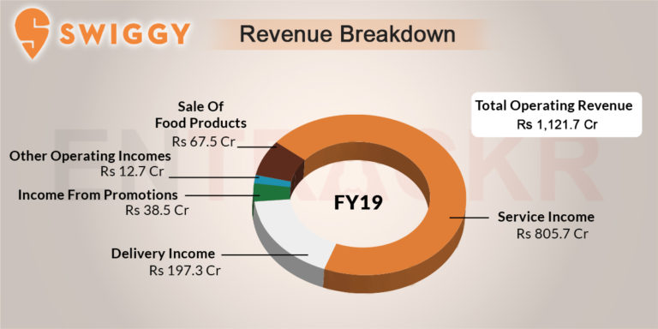
Competitor Analysis
SWIGGY Vs MASALA BOX
 | Parameters | SWIGGY | MASALA BOX
Future Initiatives | Future initiatives | Swiggy’s core business is delivering food to the customers from the restaurants and their major portion of the revenue comes from the service income so they should keep working more on this side. | Masala box will increase the different cuisines option for their customers because they are actively looking out for home chefs who have exceptional culinary skills or are adept in a particular cuisine. Party orders seems to be good additional revenue stream for them so they would like to grow their party revenue stream.
Notes:
© Copyright UpGrad Education Pvt. Ltd. All rights reserved

Slide 36
Competitor Analysis
SWIGGY Vs MASALA BOX
 | Parameters | SWIGGY | MASALA BOX
Future Initiatives | Future initiatives | Swiggy is expanding very fast in all over the India to acquire more customer base. They will keep doing this. To maintain the supply power they have started the Swiggy access which provides the space for the restaurants. They will actively work on this. This will help them improve the customer service. | They are providing very good home cooked food and service. People are really liking it so they need to do more on marketing side so that they can acquire more customers. They need to expand its geographical footprint in Bengaluru because many people are saying in reviews that their service is not available in their location.
Notes:
© Copyright UpGrad Education Pvt. Ltd. All rights reserved

Slide 37
Competitor Analysis
SWIGGY Vs MASALA BOX
 | Parameters | SWIGGY | MASALA BOX
Future Initiatives | Future initiatives | Swiggy has started multiple services like Ginie, delivering groceries, fruits & vegetables they should keep working on this revenue streams. This will help them to come across with the revenue losses due to COVID-19
Notes:
© Copyright UpGrad Education Pvt. Ltd. All rights reserved

Slide 38
Part 2: User Research
Notes:
© Copyright UpGrad Education Pvt. Ltd. All rights reserved

Slide 39
Objectives and Hypotheses
Objectives –
The object is to understand why people would prefer homemade food instead of restaurant food?
The objective is to understand what they will expect from homemade food suppliers?
Hypothesis –
HYP1 - Given an option, people would prefer homemade to restaurant-made food.
HYP2 - Speed of delivery is a major factor that public consider while ordering online.
HYP3 - People would prefer short-term weekly subscriptions over long-term monthly subscriptions
HYP4 - People order outside food because they crave variety
Notes:
© Copyright UpGrad Education Pvt. Ltd. All rights reserved

Slide 40
Surveys - Questionnaire
Survey questionnaire link - https://forms.gle/WScSdN3s2kBkD9hh6
Notes:
© Copyright UpGrad Education Pvt. Ltd. All rights reserved

Slide 41
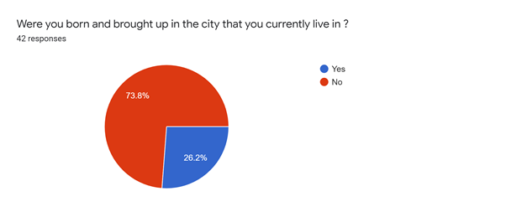
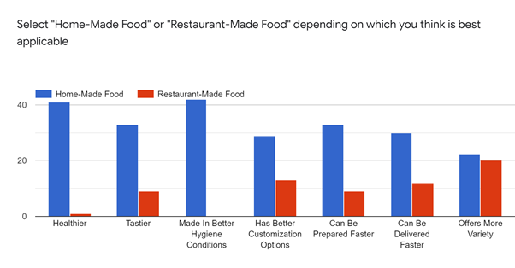
Surveys - Analysis
As represented by the pie-chart, a significant proportion of the respondents are migrants who have moved to the current city for work or other reasons.
The bar graph clearly indicates an overwhelming preference for Home-Made food on all factors.
Restaurant-made food gives close competition to home-made food only when it comes Variety Of Offering
Notes:
© Copyright UpGrad Education Pvt. Ltd. All rights reserved

Slide 42
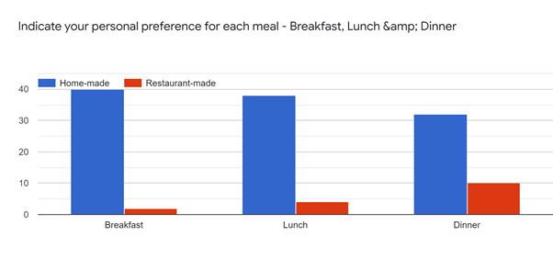
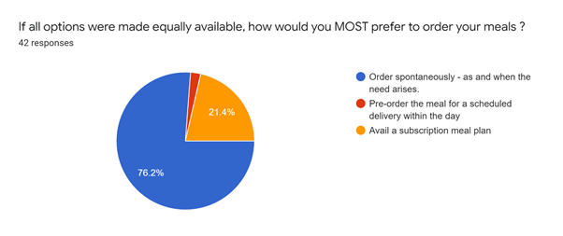
Surveys - Analysis
The bar graph clearly indicates that given a viable option an overwhelming majority of people would prefer Home-Made food to Restaurant-Made food
Hyp1 is thus validated.
The pie-chart indicates an emerging audience that would opt for subscription meal plans
Notes:
© Copyright UpGrad Education Pvt. Ltd. All rights reserved

Slide 43
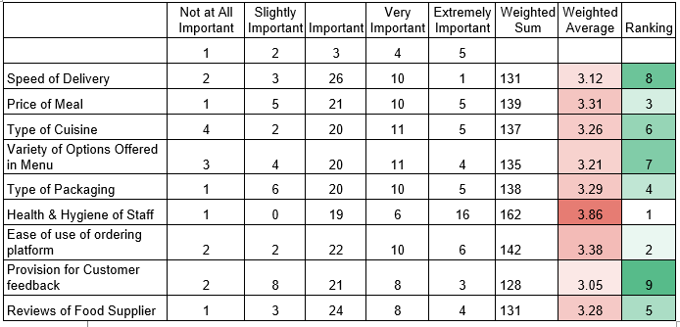
Surveys - Analysis
Listed below are a few common factors that are considered while ordering meals online. Rate them on the level of importance you would provide to each factor
As can be inferred from the chart in the left.
Health & Hygiene of Staff is of prime concern to users
Ease of use of ordering platform plays a pivotal role.
Price of meal, understandably, is a major priority.
Surprisingly, Speed of Delivery is not a prime concern as assumed in the Hypothesis. Hyp2 is thus proven invalid
Notes:
© Copyright UpGrad Education Pvt. Ltd. All rights reserved

Slide 44
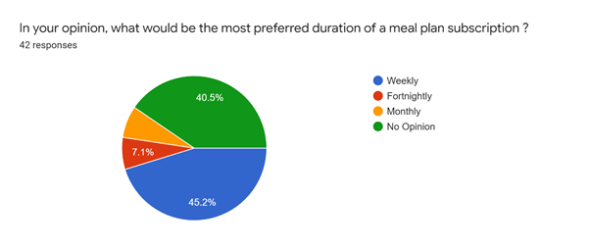
Surveys - Analysis
A majority of the respondents would prefer short-term weekly subscription plans to long-terms monthly subscription plans. Hyp3 is thus validated
Notes:
© Copyright UpGrad Education Pvt. Ltd. All rights reserved

Slide 45
Interviews - Questions
DEMOGRAPHIC QUESTIONS
In which age group do you fall?
Please select your gender
Would you mind sharing your current relationship status?
Which city/town/village were you born and brought up in?
Which city do you live in currently?
What is your occupation?
What are your favorite past times?
Notes:
© Copyright UpGrad Education Pvt. Ltd. All rights reserved

Slide 46
Interviews - Questions
PERSONALITY QUESTIONS
How actively do you engage with people on a regular basis?
With whom do you majorly discuss if any critical decision to be made?
BRAND QUESTION
Could you name the brands of some products that you frequently use?
TECHNOLOGY QUESTIONS
What kind of technology-based gadgets do you use on a frequent basis?
What are your favorite applications on the mobile phone?
Notes:
© Copyright UpGrad Education Pvt. Ltd. All rights reserved

Slide 47
Interviews - Questions
OPEN-ENDED QUESTIONS
Could you please share how do you manage your daily meals (breakfast/lunch/dinner)?
Could you please share how did you manage to select this source for your daily meals?
Do you use the same meal service/provider for your daily meals?
What were the key decision-making criteria to select the current meal service/provider?
Any challenge that you face with your current meal service/provider?
Notes:
© Copyright UpGrad Education Pvt. Ltd. All rights reserved

Slide 48
Interviews - Analysis
As observed with a majority of the respondents, at least 2 out of the 3 meals are not home-made. These are either ordered via online applications or are consumed in the office premises
People who engage cooks have challenges in terms of unplanned leaves.
Online deliveries are dominated by Swiggy and Zomato who rate very high in terms of customer satisfaction.
Shortage of time, uncertain working hours, eagerness to break monotony and try something new - these are the reasons why people decide to order food from outside. HYP4 is thus validated
Notes:
© Copyright UpGrad Education Pvt. Ltd. All rights reserved

Slide 49
User Research - Insights
Insights
On the basis of the survey and interview findings, the following hold to be true
Homemade food is preferred by people over restaurant-made food
2 out of 3 meals of majority of people are not home-made
There exists a proportion of people who seek subscription meal plans
Preferred meal plans are short-term weekly plans
Variety of offerings is where restaurants compete toe to toe with home made food.
One of the major reasons why people order food online or eat outside is to break the monotony and eat something different
On the basis of the above mentioned insights, a product that can deliver home-made food
on a subscription basis
in a timely manner
offering variety to the customer
will be able to address the gap that is not fulfilled by current online food delivery apps such as Swiggy or Zomato.
Notes:
© Copyright UpGrad Education Pvt. Ltd. All rights reserved

Slide 50
Part 3: Business Model Canvas
Notes:
© Copyright UpGrad Education Pvt. Ltd. All rights reserved

Slide 51
Business Model Analysis
Download the complete Business model from here - https://drive.google.com/file/d/1PsZT9x8G4wXf9k6svCUF6V4FSDWfIqFM/view?usp=sharing
Also added in the zip file submitted for the assignment.
Notes:
© Copyright UpGrad Education Pvt. Ltd. All rights reserved

Slide 52
Part 4: Product Artefacts
Notes:
© Copyright UpGrad Education Pvt. Ltd. All rights reserved

Slide 53
User Persona
Download the user persona from here - https://drive.google.com/file/d/1jRJSnhBWruKtuMdU8GPx1yRvJibL7fi2/view?usp=sharing
Also added in the template provided for the submission in zip file.
Notes:
© Copyright UpGrad Education Pvt. Ltd. All rights reserved

Slide 54
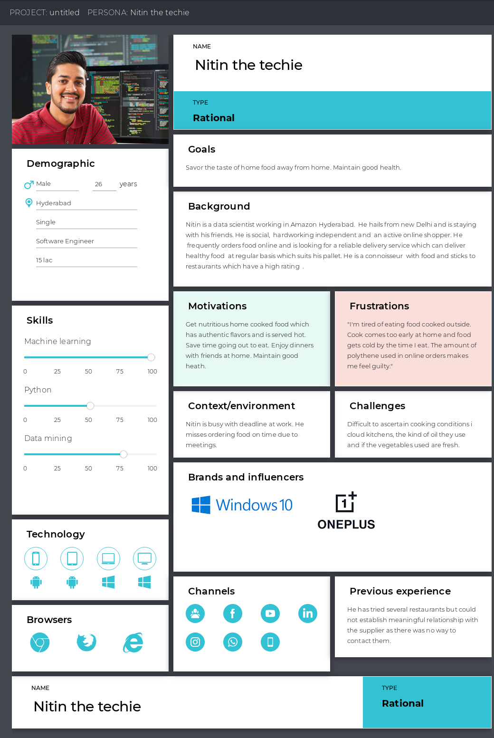
User Persona
Notes:
© Copyright UpGrad Education Pvt. Ltd. All rights reserved

Slide 55
User Journey Map
Download the user journey map from here -
https://drive.google.com/file/d/1czD-IC_tgzNHreg19z_tKQVq4Feyrk9S/view?usp=sharing
Also added in the template provided for the submission in zip file.
Notes:
© Copyright UpGrad Education Pvt. Ltd. All rights reserved

Slide 56
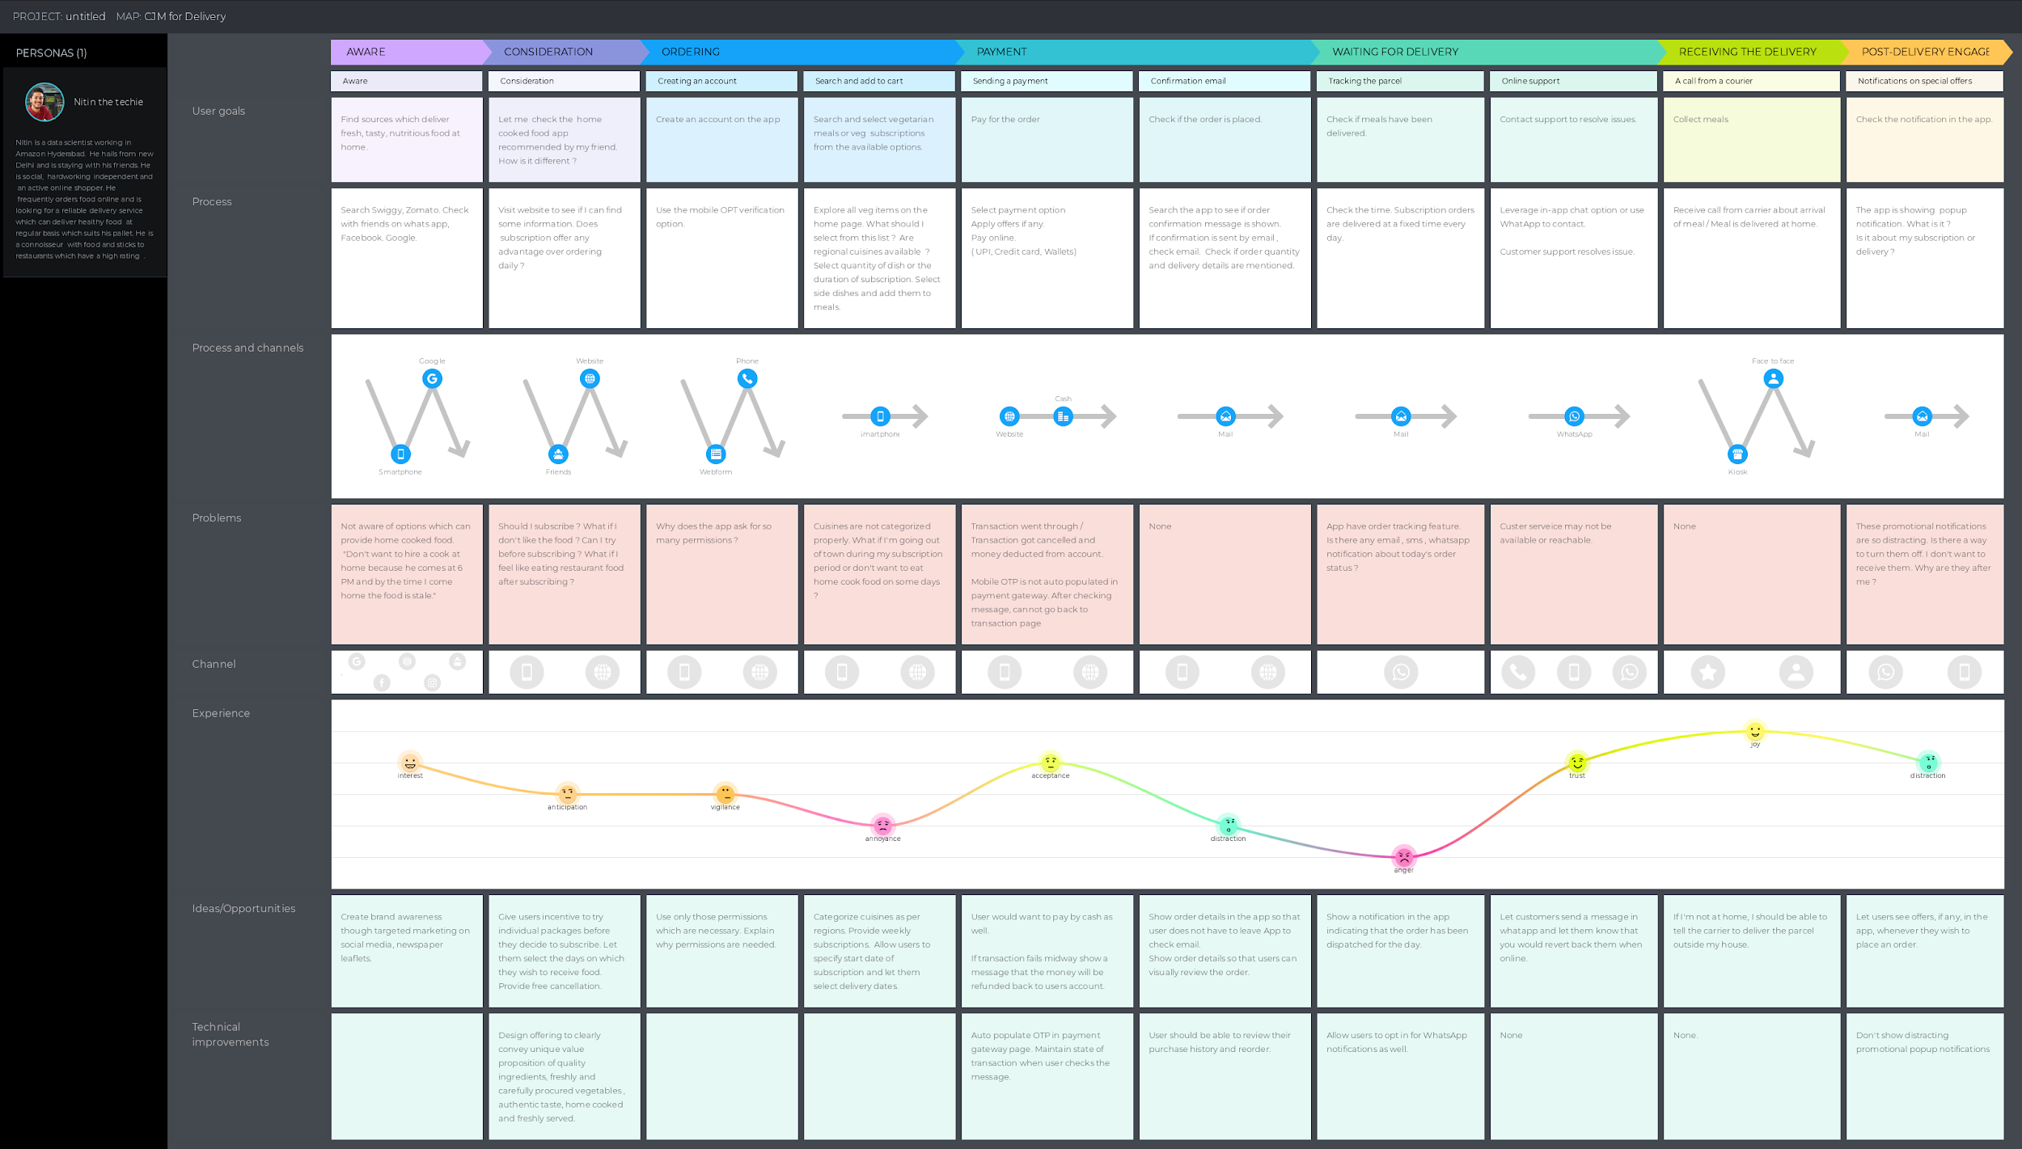
User Journey Map
Notes:
© Copyright UpGrad Education Pvt. Ltd. All rights reserved

Slide 57
Part 5: Minimum Viable Product Creation
Notes:
© Copyright UpGrad Education Pvt. Ltd. All rights reserved

Slide 58
Features/Functionalities
Login/Registration feature - This is the first most step for the customer in the app. We Consider only basic & essential details to be entered by the user, such as Name, Address, contact number, Social media registration, etc. The registration should be highly smooth & easy for the user, and not complicated like the user is filling a passport form.
Easy searching for food - This is the second most important feature. A starving user couldn’t wait to find scrumptious food and then order it. After logging in and profile customization, the user is going to look for what they should eat
Meal Customization - Variety is a majority dictating factor that customer seek while ordering food online. Providing them with a customization feature will aid in customer retention and growth.
Adding Food to Cart: Adding food to the cart also plays an important role in the user flow. Changing the quantity of the same item should be highly easy
Delivery Person’s Contact Info - When the delivery executive gets assign to the order delivery, we should provide the customer with the contact information of the delivery person. This way they will have an easier time to contact the delivery guy and get the information about where they are and how long it’ll take for them to deliver.
Notes:
© Copyright UpGrad Education Pvt. Ltd. All rights reserved

Slide 59
Features/Functionalities
Easy Payment: Payment is the ultimate part of the app’s business. Should include multiple payment options for the ease of payment.
Order History - Order history is also a necessary feature for a smart food delivery app. It helps the user to check which was the provider from whom they earlier did an order. It is convenient for placing similar orders without searching again and again. It also lets the customer check the rates and bills of previous orders.
Real-time Food Tracking: With this feature, the user can easily track their order and what is its status. This will make them less annoyed during the waiting.
Review & Rating the food: The customers should allow to rate & review for the food items they have ordered.
Navigation and GPS tracking: This is the most important feature for a delivery boy because he would be able to find out the location by the navigations. They would be able to find out the location with an in-built navigation system in the app.
Notes:
© Copyright UpGrad Education Pvt. Ltd. All rights reserved

Slide 60
Features/Functionalities
Updating Status: After getting the order, the delivery would be able to update the status, such as Order has been picked up, the order has been delivered, delayed, etc. As soon as the delivery boy updates the status, the customer will get a push notification for a smooth flow.
Analytics - Analytics will help the Food suppliers know all about how much they are earning from the online food delivery app, how many customers they have, how many orders they are getting daily, etc. the analytics is going to get them a clear view of the business and help them keep an eye on everything.
OFFERS, PROMO CODES, OR DISCOUNTS: Discount has always been a fantastic way to captivating the users. We can provide coupons, discounts, promo codes which the users can add in the Promo code section for availing exciting discounts. At the initial level, it can help us to gain a wide pool of customers.
Notes:
© Copyright UpGrad Education Pvt. Ltd. All rights reserved

Slide 61
Must Have Features
Feature | Reason behind choosing this as a ‘Must Have Feature’
Login/Registration feature - | This is the first most step for the customer in the app. We Consider only basic & essential details to be entered by the user, such as Name, Address, contact number, Social media registration, etc. The registration should be highly smooth & easy for the user, and not complicated like the user is filling a passport form.
Easy searching/listing for food | This is the second most important feature. A starving user couldn’t wait to find scrumptious food and then order it. After logging in and profile customization, the user is going to look for what they should eat
Adding Food to Cart | Adding food to the cart also plays an important role in the user flow. Changing the quantity of the same item should be highly easy
Notes:
© Copyright UpGrad Education Pvt. Ltd. All rights reserved

Slide 62
Must Have Features
Feature | Reason behind choosing this as a ‘Must Have Feature’
Meal Customization | Customers should have the freedom to customize a meal as per their preferences
Easy Payment: | Payment is the ultimate part of the app’s business. Should include multiple payment options for the ease of payment.
Review & Rating the food | The customers should be allowed to rate & review for the food items they have ordered.
Adding Food to Cart | Adding food to the cart also plays an important role in the user flow. Changing the quantity of the same item should be highly easy
Notes:
© Copyright UpGrad Education Pvt. Ltd. All rights reserved

Slide 63
Must Have Features
Feature | Reason behind choosing this as a ‘Must Have Feature’
Customer support | Necessary to make customer relationship
Order History | Order history is also a necessary feature for a smart food delivery app. It helps the user to check which was the provider from whom they earlier did an order. It is convenient for placing similar orders without searching again and again. It also lets the customer check the rates and bills of previous orders.
Notes:
© Copyright UpGrad Education Pvt. Ltd. All rights reserved

Slide 64
Nice to Have Features
Delivery Person’s Contact Info - When the delivery executive gets assign to the order delivery, we should provide the customer with the contact information of the delivery person. This way they will have an easier time to contact the delivery guy and get the information about where they are and how long it’ll take for them to deliver.
Real-time Food Tracking: With this feature, the user can easily track their order and what is its status. This will make them less annoyed during the waiting.
Navigation and GPS tracking: This is the most important feature for a delivery boy because he would be able to find out the location by the navigations. They would be able to find out the location with an in-built navigation system in the app.
Updating Status: After getting the order, the delivery would be able to update the status, such as Order has been picked up, the order has been delivered, delayed, etc. As soon as the delivery boy updates the status, the customer will get a push notification for a smooth flow.
Analytics - Analytics will help the Food suppliers know all about how much they are earning from the online food delivery app, how many customers they have, how many orders they are getting daily, etc. the analytics is going to get them a clear view of the business and help them keep an eye on everything.
Notes:
© Copyright UpGrad Education Pvt. Ltd. All rights reserved

Slide 65
Nice to Have Features
OFFERS, PROMO CODES, OR DISCOUNTS:
Discount has always been a fantastic way to captivating the users. We can provide coupons, discounts, promo codes which the users can add in the Promo code section for availing exciting discounts. At the initial level, it can help us to gain a wide pool of customers.
Notes:
© Copyright UpGrad Education Pvt. Ltd. All rights reserved

Slide 66
Part 6: Sketching
Notes:
© Copyright UpGrad Education Pvt. Ltd. All rights reserved

Slide 67
Features
Page name | It’s Features/Functionalities
User Login / Signup | New user onboarding through mobile & Google login. Existing user sign-in
Personal Details | Collates user details
OTP Confirmation | Secure channel for verification
Favorite Cuisines | Collates user preferences to provide curated experience
Landing Page with Explainer Video | Helpful to ensure new users are coached early on how to use the application.
Home Page | The focal point of the product. Provides a snapshot of all the product has to offer
Base Meal Customization | Helps user choose options within a meal as per his preference
Add-Ons | Provides the user with option to add more variety to his meal
Notes:
© Copyright UpGrad Education Pvt. Ltd. All rights reserved

Slide 68
Features
Page name | It’s Features/Functionalities
Cart | A quick snapshot of all shopping components along with total order value
Search | Provides user with the option to search for what he/she seeks by typing into a search field
Payment | Provides multiple payment avenues for order placement
Order Confirmation | Communicates order confirmation and acknowledgement of order placement via mobile and email
Order History | Easy access to all orders placed
Active Meals | Easy access to ongoing active subscriptions
Meal Review | Avenue for providing active feedback on individual meal components
User Account | Helpful in accessing user-specific details as well as product-aided guidance
Customer Support | Avenue to communicate queries/complaints/feedback in addition to meal reviews
Notes:
© Copyright UpGrad Education Pvt. Ltd. All rights reserved

Slide 69
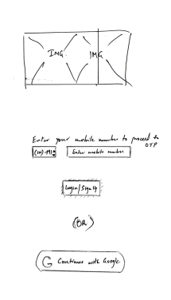
User Login/Signup Page
Image banner at the top to showcase product branding
Drop down to search for relevant ISD code for mobile phone number entry
Text field for entry of mobile phone number
Login/Signup button to proceed further to OTP page
Continue with Google button to leverage Google credentials for login
Notes:
© Copyright UpGrad Education Pvt. Ltd. All rights reserved

Slide 70
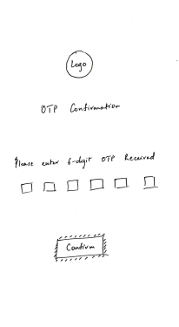
OTP Confirmation Page
Product logo at the center of page for branding purposes
Six text boxes for inputs of 6-digit OTP code
Confirm button for moving forward after confirmation of OTP
Notes:
© Copyright UpGrad Education Pvt. Ltd. All rights reserved

Slide 71
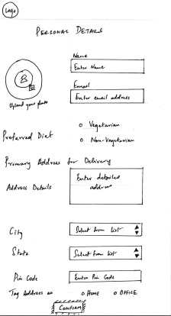
Personal Details Page
Text fields for capturing Name, Email, Detailed Address, Pin Code
Dropdowns for selecting City & State
Radio buttons for selecting Preferred Diet as well as Tagging address.
Provision for upload of photo onto profile
Confirm CTA button to move forward
Notes:
© Copyright UpGrad Education Pvt. Ltd. All rights reserved

Slide 72
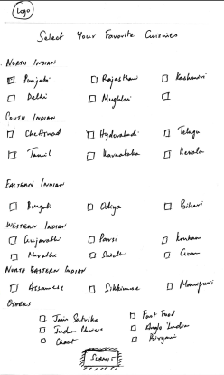
Favorite Cuisines Selection Page
Checkboxes under various headings to promote multiple choice selections.
Submit CTA button to move forward
Notes:
© Copyright UpGrad Education Pvt. Ltd. All rights reserved

Slide 73
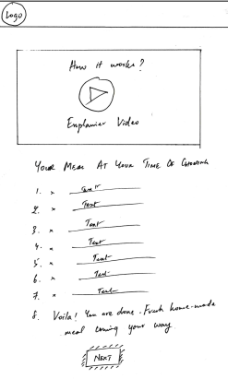
Product Explainer Page
Video link top and center to showcase explainer video and facilitate user onboarding and education.
Text-based instructions beneath the explainer video link
Next CTA button to move forward from the page
Notes:
© Copyright UpGrad Education Pvt. Ltd. All rights reserved

Slide 74
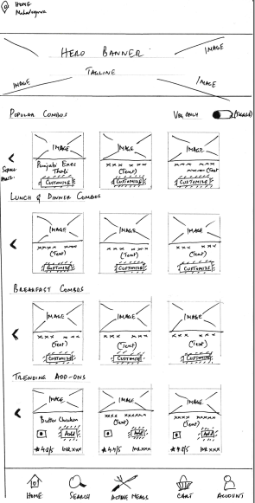
Home Page
Header contains geotag identification of location.
Large Image file immediately beneath the header that serves as the Hero Banner with the product tagline.
4 rows of Image-inscribed tiles on carousels with horizontal scrolling
Combo tile possesses Customize CTA button that would redirect to Base Meal Combo page.
Add-On tile possesses Add CTA button that would redirect to Add-On page.
Combo tiles have Image, Text & Customize CTA button
Add-On tiles have Image, Text, Diet Indicator Icon, Star Rating, Price Indicator & Add CTA button
Notes:
© Copyright UpGrad Education Pvt. Ltd. All rights reserved

Slide 75
Home Page
8. Footer consists of 5 icons
Home - directs to Home Page
Search - directs to Search Page
Active Meals - to Active Meals Page
Cart - directs to Cart
Account - directs to User Account
Notes:
© Copyright UpGrad Education Pvt. Ltd. All rights reserved

Slide 76
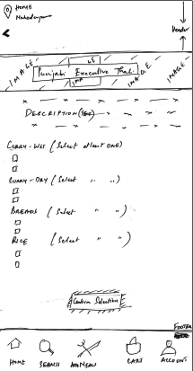
Base Meal Customization Page
Header contains geotag identification of location as well as back arrow button that would direct to the previously accessed page.
Image banner beneath the header to showcase base combo selected.
Short text description below the header to describe base combo.
Checkbox provision under multiple headings to enable multiple selections.
Confirm Selection CTA button to move forward after selections
Footer with 5 Icons also features in the page.
Notes:
© Copyright UpGrad Education Pvt. Ltd. All rights reserved

Slide 77
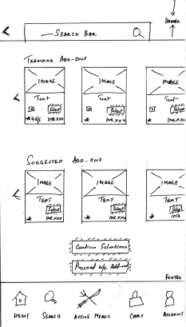
Add-Ons Page
Header consists of a prominent search bar and a back arrow
2 rows of Add-On type tiles arranged on carousels with horizontal scrolling.
Each Add-on type tile contains
Image
Text description
Veg/Non-Veg Icon
Select CTA button to select item
Star ratings of add-on
Price of add-on
Confirms Selections CTA button would move forward after selections.
Proceed without Add-Ons CTA button would ignore add-ons and proceed with previous Base Combo selection.
Footer with 5 Icons also features in page.
Notes:
© Copyright UpGrad Education Pvt. Ltd. All rights reserved

Slide 78
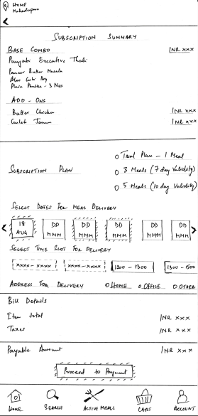
Cart Page
Header with geotag identification of location as well as back arrow button.
Footer with 5 icons also features in this page.
3 sections feature between header and footer
Subscription summary card which provides a text brief of the selections.
Subscription & Delivery details card
Bill details captured with bill details and Proceed to Payment CTA button.
Subscription & Delivery details card aids in
Selection of subscription via radio buttons.
Selection of dates for delivery via carousel-based tap on date tiles for selection
Rectangular tap on time slot tiles
Address selection via radio button
Proceed to Payment CTA button would direct to payment page.
Notes:
© Copyright UpGrad Education Pvt. Ltd. All rights reserved

Slide 79
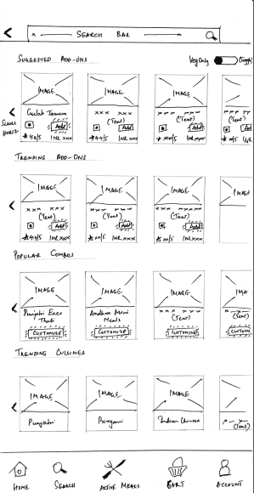
Search Page
Header features prominent search bar as well as back arrow button.
Footer with 5 icons also features in this page.
4 rows of Image-inscribed tiles on carousels with horizontal scrolling
Combo tile possesses Customize CTA button that would redirect to Base Meal Combo page.
Add-On tile possesses Add CTA button that would redirect to Add-On page.
Combo tiles have Image, Text & Customize CTA button
Add-On tiles have Image, Text, Diet Indicator Icon, Star Rating, Price Indicator & Add CTA button
Notes:
© Copyright UpGrad Education Pvt. Ltd. All rights reserved

Slide 80
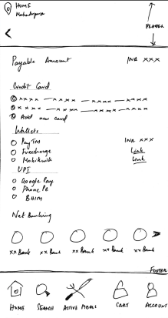
Payment Page
Header features geotag identification of location as well as back arrow button.
Footer with 5 icons also features in this page.
Payment card lists following options
Credit Card
Wallets
UPI
Netbanking
Credit Card, Wallets, UPI can be selected via radio buttons.
Netbanking can be accessed by tapping on relevant bank icon on the carousel
Selecting the appropriate option will move to Order confirmation page after successful transaction
Notes:
© Copyright UpGrad Education Pvt. Ltd. All rights reserved

Slide 81
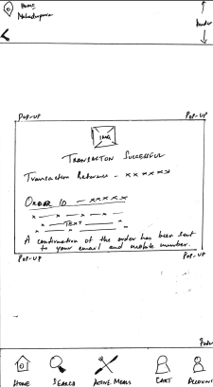
Order Confirmation Page
Order confirmation page is a Pop-Up that consists of
Image indicating success or failure of transaction.
Automatically-generated alphanumeric Transaction ID
Automatically-generated alphanumeric Order ID
Text indicating some details and references.
Text message at bottom of pop-up confirmation communication of order details via email and mobile phone.
Notes:
© Copyright UpGrad Education Pvt. Ltd. All rights reserved

Slide 82
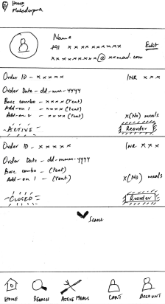
Order History Page
Header features geotag identification of location
Footer with 5 icons also features in this page.
Immediately below the header is a user profile card indicating
Name
Mobile Number
Email
Edit link to edit above details
Orders are listed separately in vertically arranged cards that can be scrolled vertically.
Each order card consists of
Order ID via alphanumeric text.
Order data in dd-mmm-yyyy format.
Order details - base combo & add-ons
Reorder CTA button in the bottom right corner that directs to Cart page with order details of current order.
ACTIVE/CLOSED indicator in left bottom corner to indicate order status.
Notes:
© Copyright UpGrad Education Pvt. Ltd. All rights reserved

Slide 83
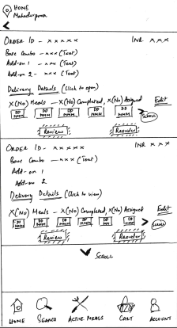
Active Meals Page
Header features geotag identification of location as well as back arrow button for access to previous page
Footer with 5 icons also features in this page.
Active meals are listed as cards with vertical scrolling feature
Each Active Meal card indicates
Order ID via alphanumeric text
Order details via text
Delivery details hyperlink to access delivery slot & address details.
Horizontal carousel of date tiles.
Status text indicating how many meals have been completed and how many assigned.
Edit hyperlink for selecting different dates for assigned meals
Review & Reorder CTA buttons
Review CTA button would redirect to the Meal Review Page
Reorder CTA button would redirect to the Cart with the order details from the current order
Notes:
© Copyright UpGrad Education Pvt. Ltd. All rights reserved

Slide 84
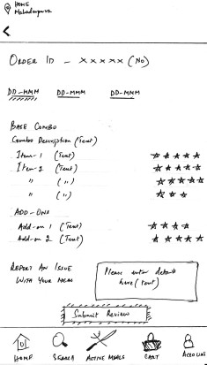
Meal Review Page
Header features geotag identification of location as well as back arrow button for access to previous page
Footer with 5 icons also features in this page.
Order ID is indicated clearly at the top
Dates are arranged on horizontal tabs
Selecting the relevant date tab would aid the user in reviewing the meal for that particular date only
The review section consists of
Star ratings on a 5-Star scale for each individual food item in the order.
Text field for capturing any additional queries/complaints/issues that the customer might have.
Submit Review CTA button to submit the review
Notes:
© Copyright UpGrad Education Pvt. Ltd. All rights reserved

Slide 85
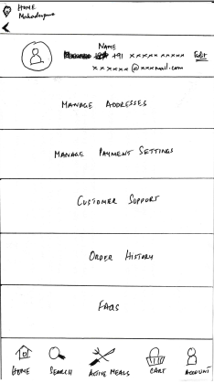
User Account Page
Header features geotag identification of location as well as back arrow button for access to previous page
Footer with 5 icons also features in this page.
Space between the Header & Footer is split equally into 6 rectangular tiles
User Profile with edit hyperlink for editing name, mobile number, email
Manage Addresses Tile
Manage Payment Settings Tile
Customer Support Tile
Order History Tile
FAQs Tile
Each of the tiles listed redirects to relevant sections.
Notes:
© Copyright UpGrad Education Pvt. Ltd. All rights reserved

Slide 86
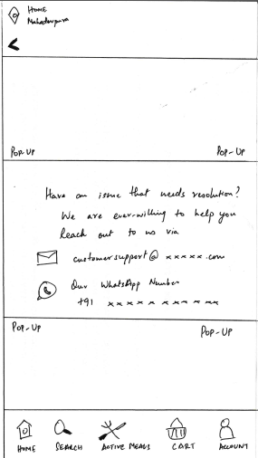
Customer Support Page
Customer support page is a pop-up page that gets enabled upon tapping on the Customer Support tile in the Accounts Page
The pop-up provides the user with the following means to communicate with the product team
Customer support email
Whatsapp number
Notes:
© Copyright UpGrad Education Pvt. Ltd. All rights reserved

Slide 87
Part 7: Wireframing and Prototyping
Notes:
© Copyright UpGrad Education Pvt. Ltd. All rights reserved

Slide 88
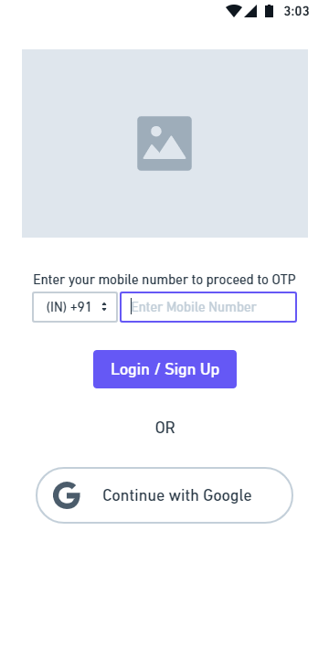
User Login/Signup Page
Notes:
© Copyright UpGrad Education Pvt. Ltd. All rights reserved

Slide 89
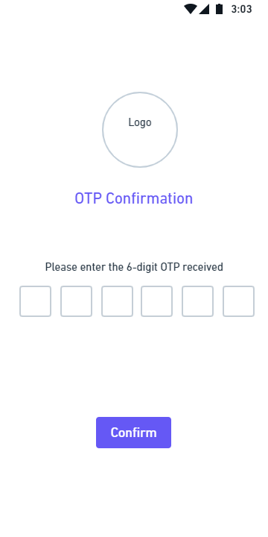
OTP Confirmation Page
Notes:
© Copyright UpGrad Education Pvt. Ltd. All rights reserved

Slide 90
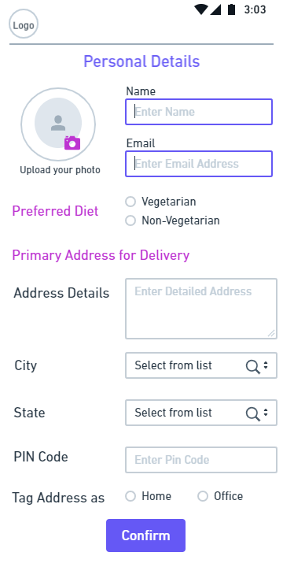
Personal Details Page
Notes:
© Copyright UpGrad Education Pvt. Ltd. All rights reserved

Slide 91
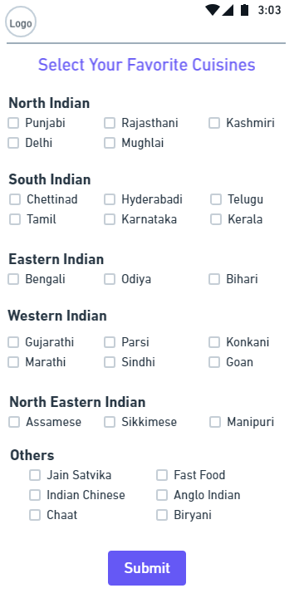
Favorite Cuisines Selection Page
Notes:
© Copyright UpGrad Education Pvt. Ltd. All rights reserved

Slide 92
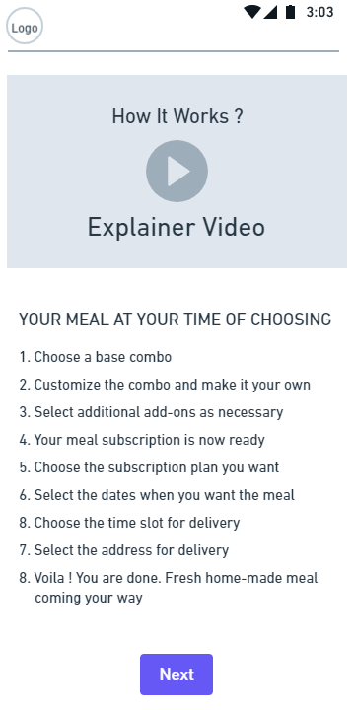
Product Explainer Page
Notes:
© Copyright UpGrad Education Pvt. Ltd. All rights reserved

Slide 93
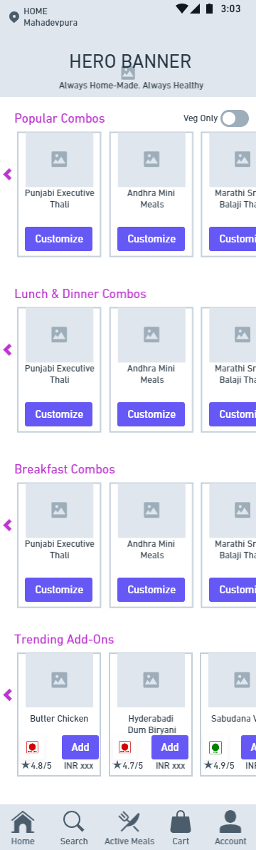
Home Page
Notes:
© Copyright UpGrad Education Pvt. Ltd. All rights reserved

Slide 94
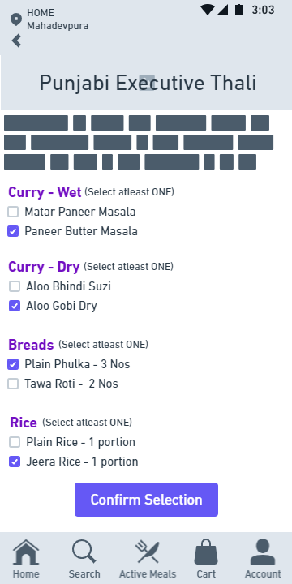
Base Meal Customization Page
Notes:
© Copyright UpGrad Education Pvt. Ltd. All rights reserved

Slide 95
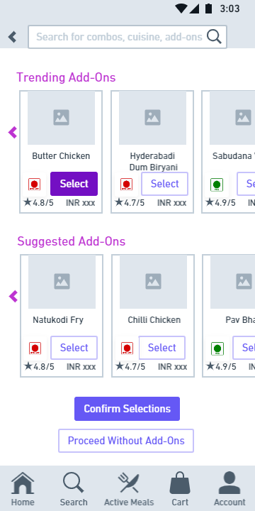
Add-Ons Page
Notes:
© Copyright UpGrad Education Pvt. Ltd. All rights reserved

Slide 96
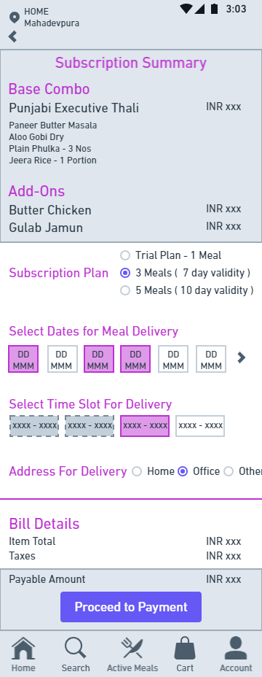
Cart Page
Notes:
© Copyright UpGrad Education Pvt. Ltd. All rights reserved

Slide 97
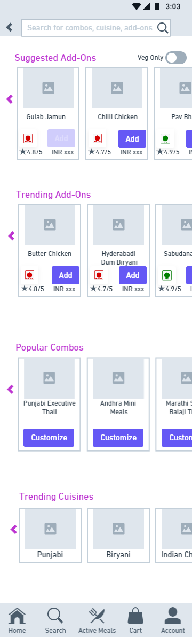
Search Page
Notes:
© Copyright UpGrad Education Pvt. Ltd. All rights reserved

Slide 98
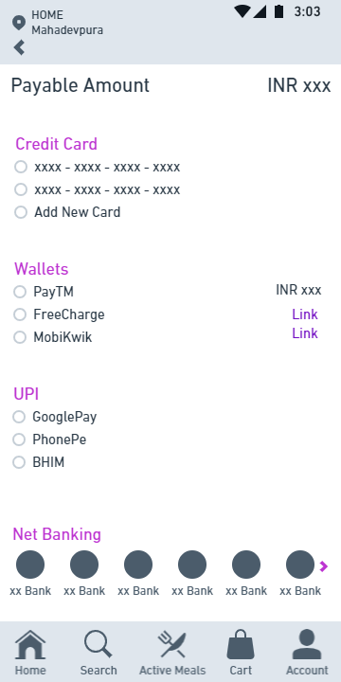
Payment Page
Notes:
© Copyright UpGrad Education Pvt. Ltd. All rights reserved

Slide 99
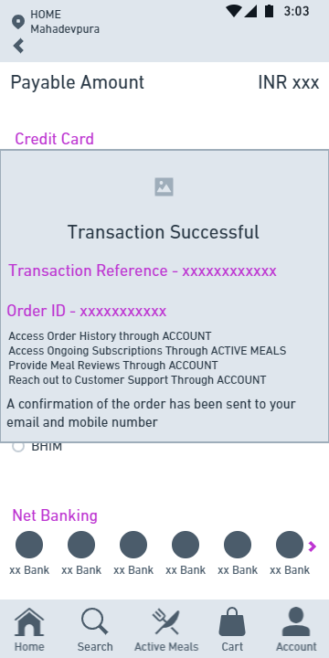
Order Confirmation Page
Notes:
© Copyright UpGrad Education Pvt. Ltd. All rights reserved

Slide 100
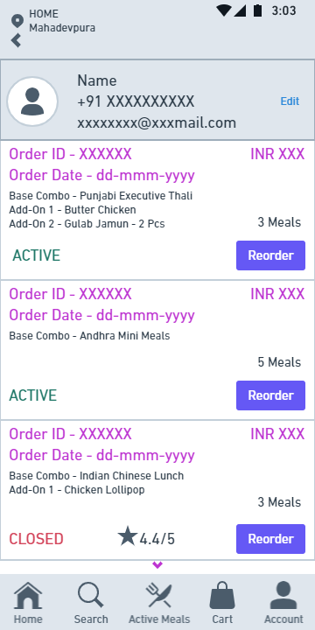
Order History Page
Notes:
© Copyright UpGrad Education Pvt. Ltd. All rights reserved

Slide 101
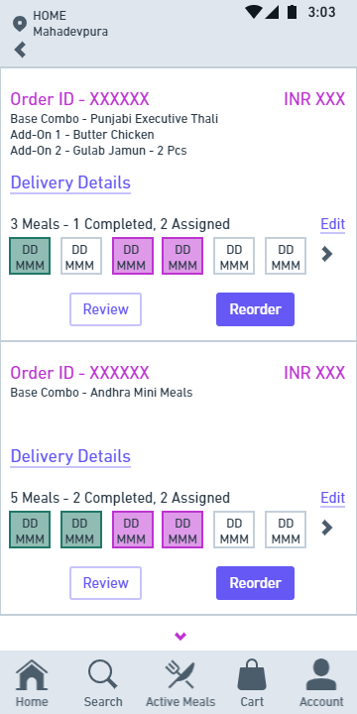
Active Meals Page
Notes:
© Copyright UpGrad Education Pvt. Ltd. All rights reserved

Slide 102
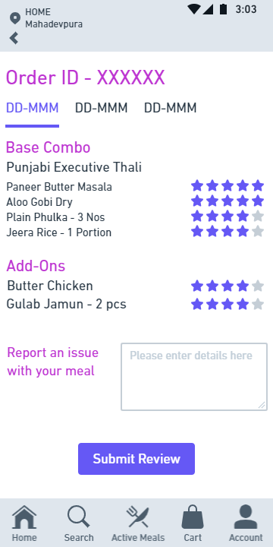
Meal Review Page
Notes:
© Copyright UpGrad Education Pvt. Ltd. All rights reserved

Slide 103
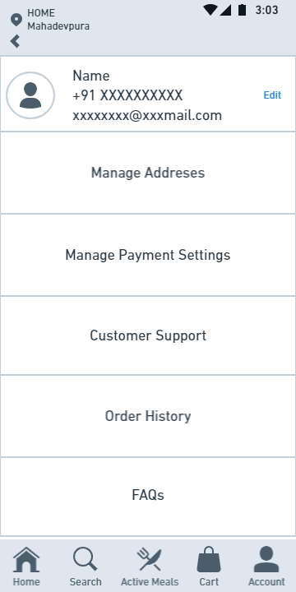
User Account Page
Notes:
© Copyright UpGrad Education Pvt. Ltd. All rights reserved

Slide 104
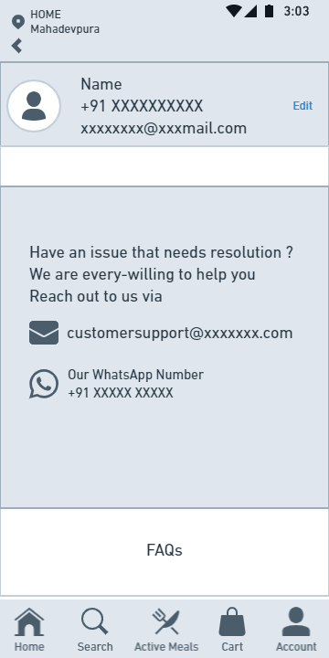
Customer Support Page
Notes:
© Copyright UpGrad Education Pvt. Ltd. All rights reserved

Slide 105
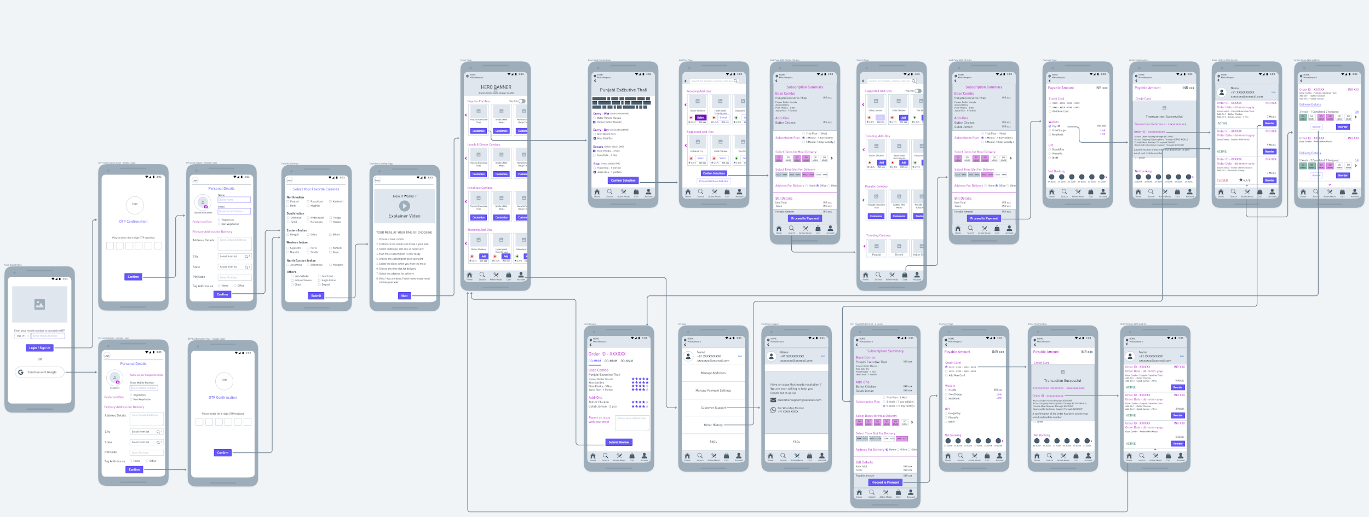
Navigational Flow
Access the navigation flow at this link - https://whimsical.com/UFL6j3D14YZq9RKo4rmwTD
Notes:
© Copyright UpGrad Education Pvt. Ltd. All rights reserved

Slide 106
Tools used
Wireframing | Whimsical
Prototyping | Marvel
Notes:
© Copyright UpGrad Education Pvt. Ltd. All rights reserved

Slide 107
Prototyping
Prototyping | https://marvelapp.com/prototype/90672g3
Notes:
© Copyright UpGrad Education Pvt. Ltd. All rights reserved

Slide 108
Disclaimer: All content and material on the UpGrad website is copyrighted material, either belonging to UpGrad or its bonafide contributors and is purely for the dissemination of education. You are permitted to access print and download extracts from this site purely for your own education only and on the following basis:
You can download this document from the website for self-use only.
Any copies of this document, in part or full, saved to disc or to any other storage medium may only be used for subsequent, self-viewing purposes or to print an individual extract or copy for non-commercial personal use only.
Any further dissemination, distribution, reproduction, copying of the content of the document herein or the uploading thereof on other websites or use of content for any other commercial/unauthorized purposes in any way which could infringe the intellectual property rights of UpGrad or its contributors, is strictly prohibited.
No graphics, images or photographs from any accompanying text in this document will be used separately for unauthorised purposes.
No material in this document will be modified, adapted or altered in any way.
No part of this document or UpGrad content may be reproduced or stored in any other web site or included in any public or private electronic retrieval system or service without UpGrad’s prior written permission.
Any rights not expressly granted in these terms are reserved.

